Slide 1
Absence Tracking Year End Processing
Six Steps

Slide 2
Year End Processing in Six Steps!
Run June Monthly Accrual and Report (ABT400)
Print June Accrual Report (ABT400) to check leave accrual balances
Correct any mistakes in leave balances for current Fiscal Year (Y1)
Run Reset and Balance Forward Process and Report (ABT920) in Report Only mode
Check balances for accuracy
Run Reset and Balance Forward Process and Report(ABT920) in Update and Report mode (Y1)
Run July Absence Accrual and Report (ABT400) in new Fiscal Year (Y2)
Accrue Annual Leave
Accrue Monthly Leave

Slide 3
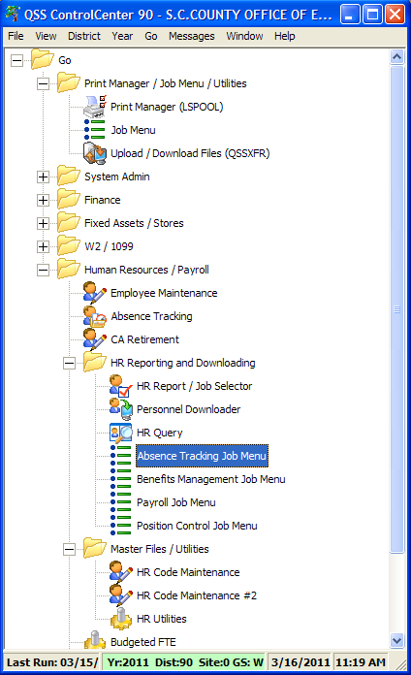
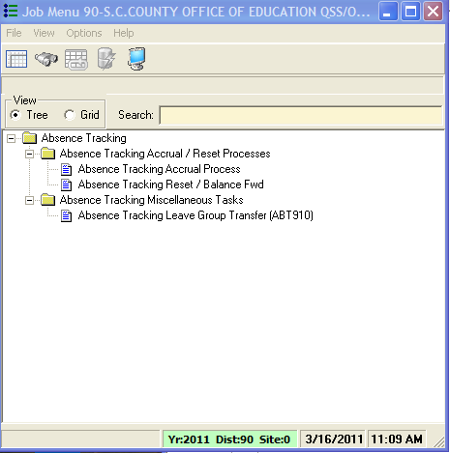
Step 1 – Run June Monthly Accrual
If your district has monthly accruals

Slide 4
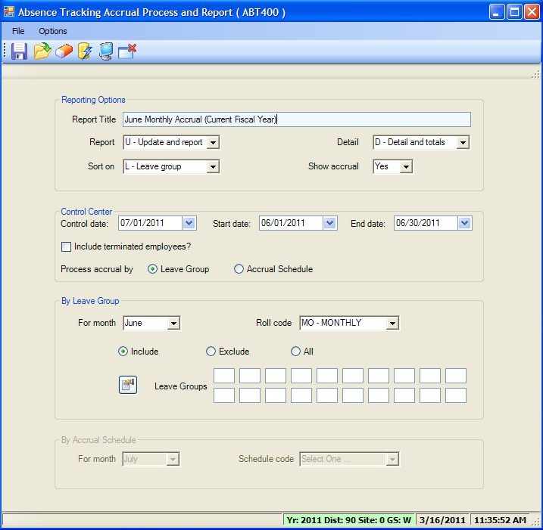
Step 1 – Run June Monthly Accrual
Absence Tracking Accrual Process and Report (ABT400)

Slide 5
Step 1 – Points to Remember
Complete only if you accrue monthly
Employee FTE:
Used “as of” the Control Date for Prorating an employee’s leave
Control Date:
Used as the basis for computing length of service for Service Year tiers
You can accrue leave by:
Leave Group - or -
Accrual Schedule (but not both)
Accrual Schedule is rarely used

Slide 6
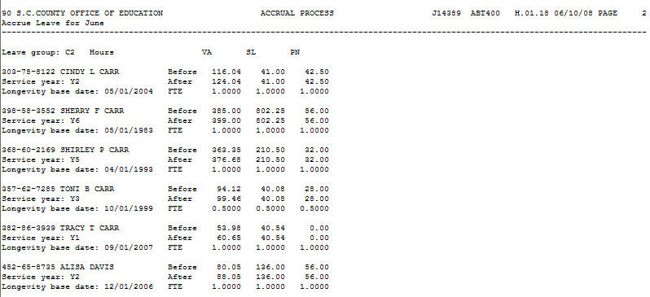
Step 2 – Print June Accrual Process Report
Sample Accrual Process Report (ABT400)
Check for errors

Slide 7
Step 3 – Correct any Mistakes
Correct any mistakes in leave balances for current fiscal year (Y1)
Especially sick and vacation balances

Slide 8
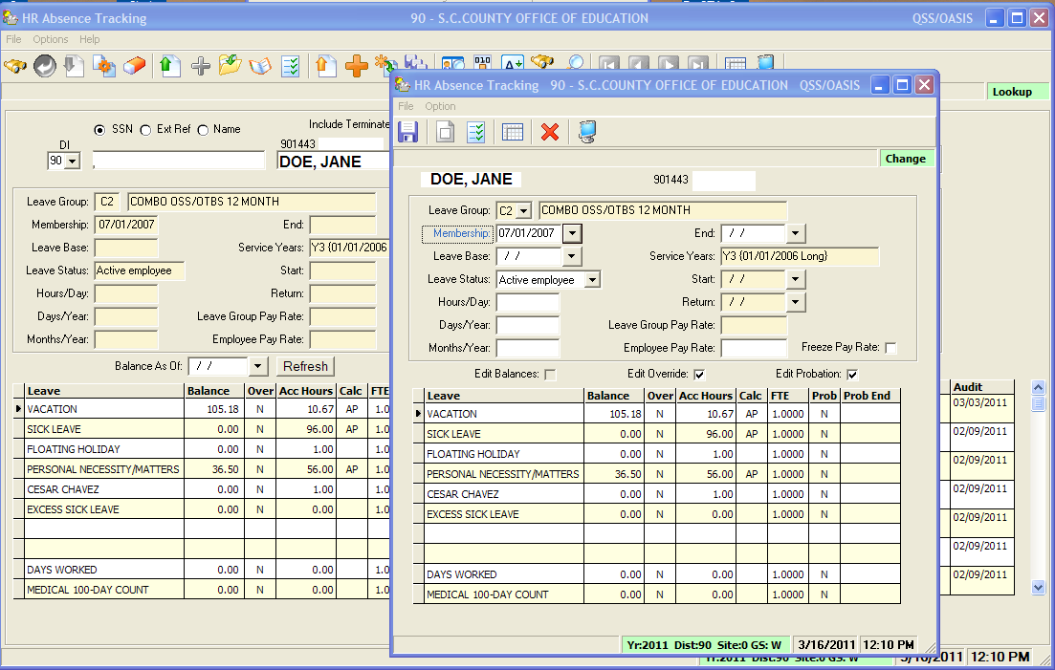
Step 3 - Correct any Mistakes
Make adjustments on the Main Absence Tracking Screen

Slide 9
Step 4 – Run Reset/Balance Forward Process (ABT920)
Reset Process clears out all buckets and resets to beginning of year balance
Balance Forward Process creates a summary record for each employee absence bucket in the new Fiscal Year (Y2).
To provide a balance forward amount and retain detail records:
Select “Yes” to create balance forward transactions
Use an old date (before Absence Tracking implementation)

Slide 10
Step 4 - Reset Codes Defined
M = Reset only month accrual indicators for each Bucket name
E = Reset only employee bucket balances for each Bucket name
B = Reset both
(see Page 4-55 of QSS Absence Tracking Manual for more information)

Slide 11
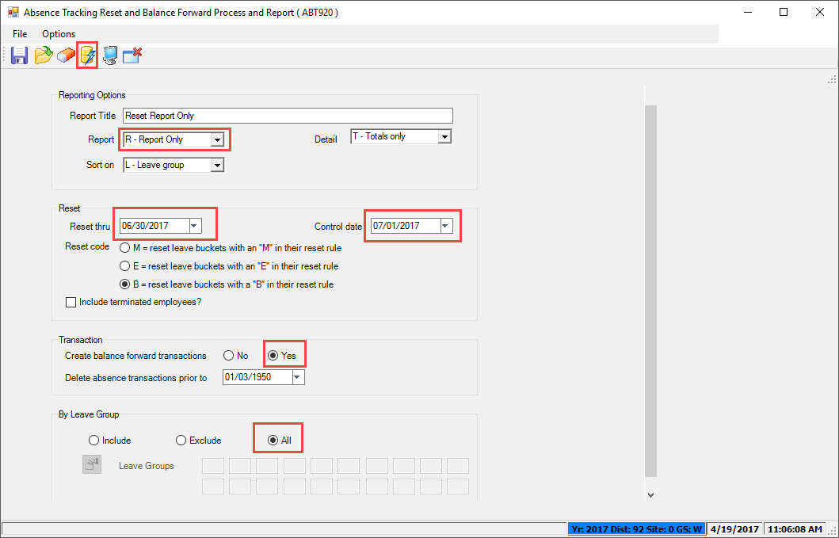
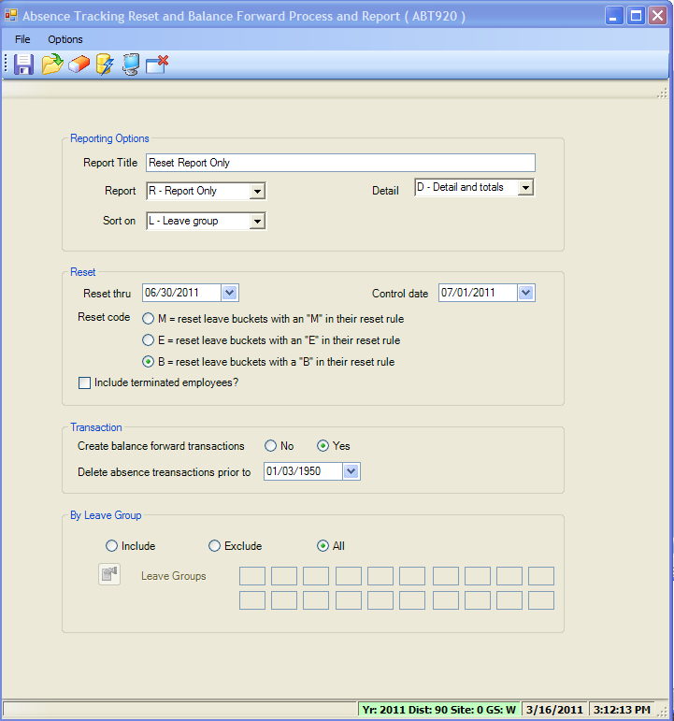
Step 4 – Run Reset/Balance Forward Process (ABT920)
Report-only for current fiscal year (Y1)

Slide 12
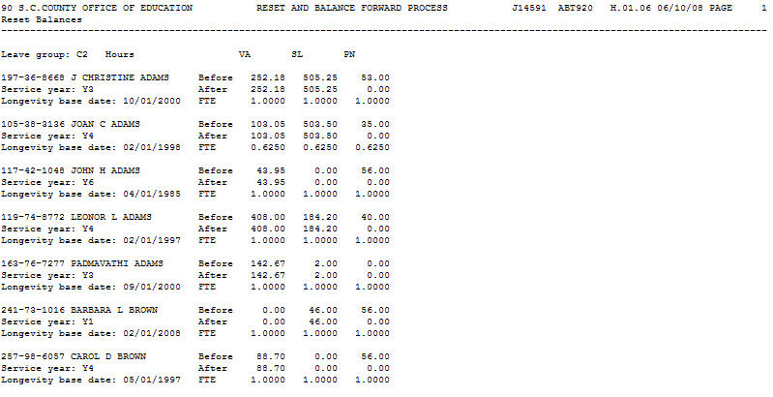
Step 4 – Run Reset/Balance Forward Process (ABT920)
Sample Reset Process Report (ABT920)

Slide 13
Step 4 – Points to Remember
Verify all balances are correct

Slide 14
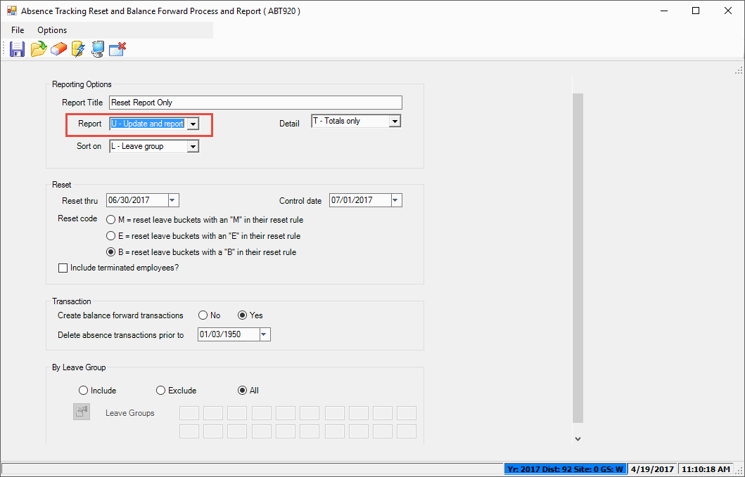
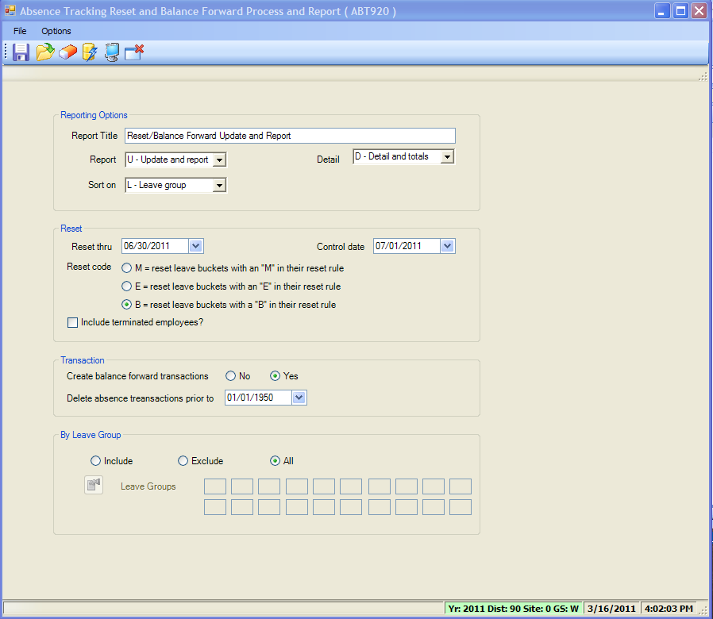
Step 5 – Run Reset/Balance Forward Process (ABT920)
Update and Report for current fiscal year (Y1)

Slide 15
Step 5 - Points to Remember
Print and save a hard copy of the Update report for future reference

Slide 16
Step 6 – Run July Absence Accrual
Log in to new FY (Y2):
Run Absence Accrual (ABT400) to accrue leave totals for each bucket
Run twice in July (if your district accrues both annually and monthly)
Print and save a hard copy of the Update report for future reference

Slide 17
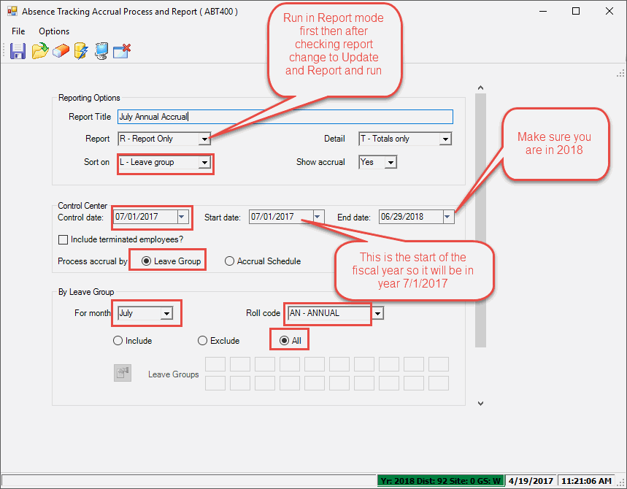
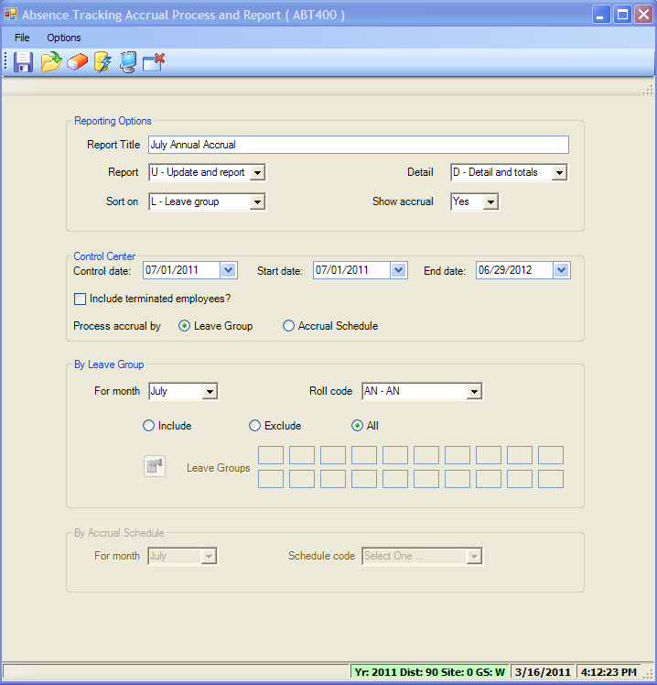
Step 6 – Run July Annual Absence Accrual
July Annual Accrual (ABT400)for new Fiscal Year (Y2)

Slide 18
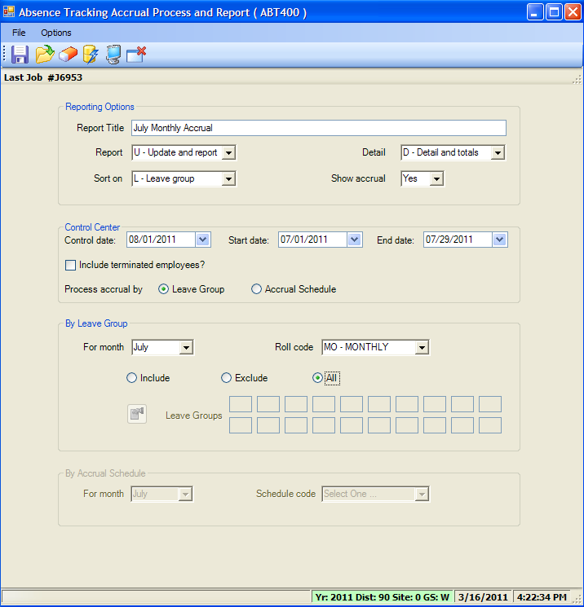
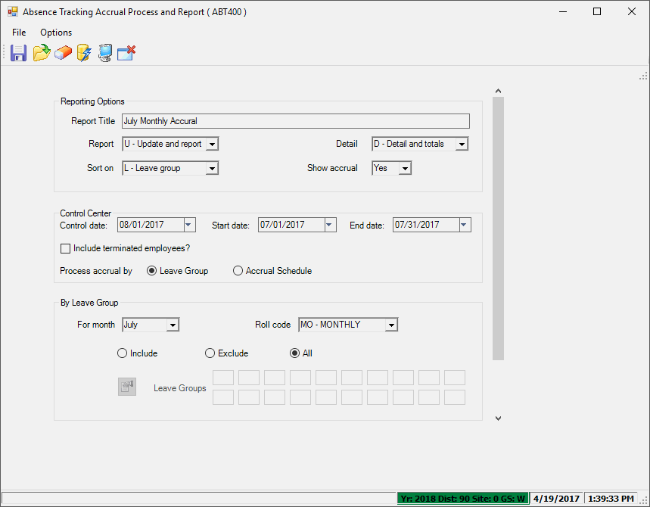
Step 6 – Run July Monthly Absence Accrual
July Monthly Accrual (ABT400)for new Fiscal Year (Y2)

Slide 19
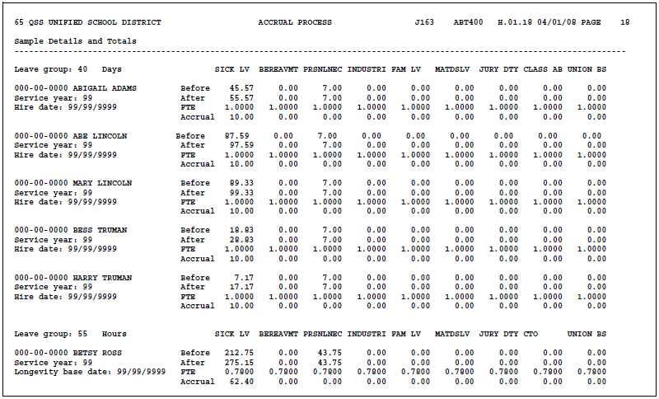
Step 6 – Run July Annual Absence Accrual
Sample Report (ABT400)

Slide 20
Step 6 - Points to Remember
For Annual Accrual
Use July 1 as Control Date
For July Monthly Accrual
Use August 1 as Control Date

